Slide 1


WHAT IS BEHIND GEORGIA’S RAPID CYBERSECURITY DEVELOPMENT
Nata Goderdzishvili
Tallinn, 4 October 2017
25 MAY 2017

Slide 2
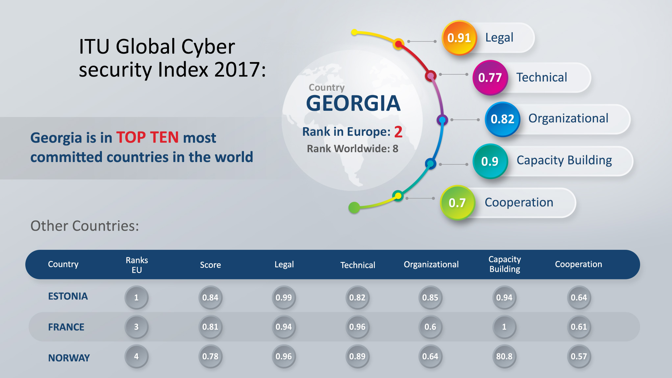

International Recognition of
Georgia’s cyber achievements

Slide 3
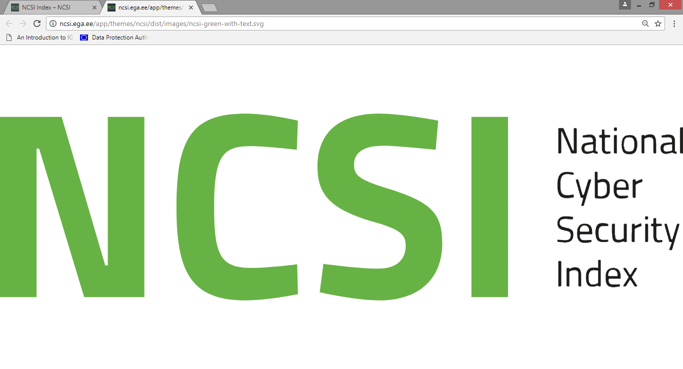
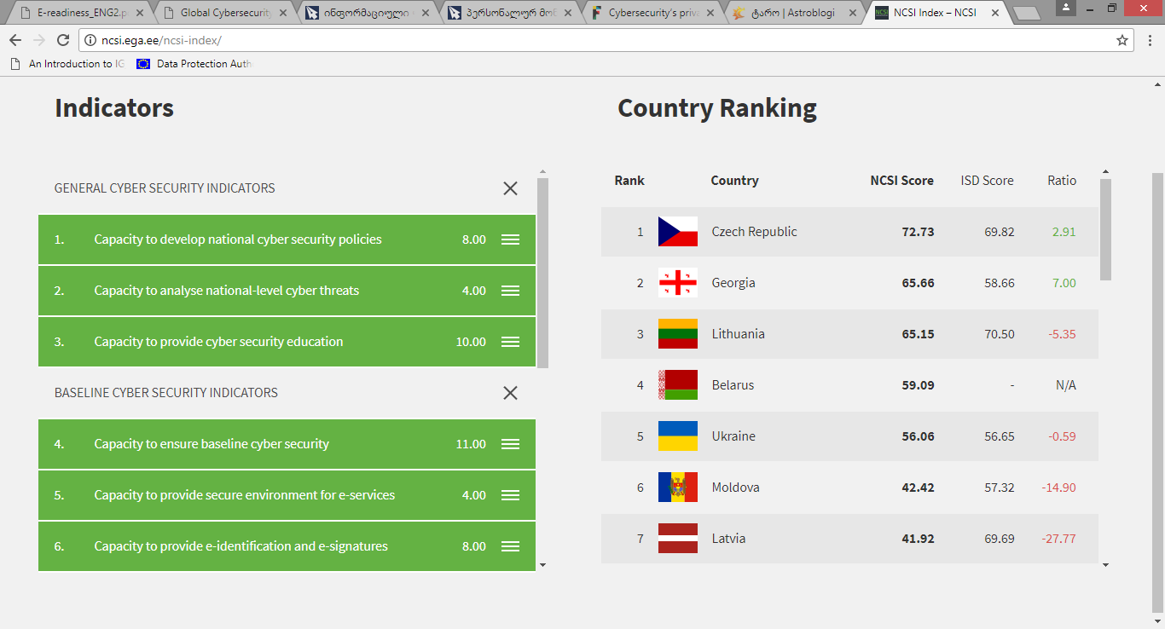

International Recognition of
Georgia’s cyber achievements
georgia
100%
100%
100%
100%
100%
89%
75%
64%
40%
33%
20%
20%

Slide 4
Key motivators for development of nation-wide cyber security framework
`
e-government & act infrastructure
information society
cyber threats & attacks

Slide 5

Lessons The Legacy Circa 2000-2010
aftermath Reform Agenda
Strategic and political alignment
Solid institutional setting
Enforceable legal framework
Proficiency and cyber professionalism
Trust based public-private partnership
International partnership
e-Skilled information society

Slide 6
#keypillarsforsuccess
I. Strategic and political alignment
National values:
Freedom
Democracy & rule of law
SECURITY
Prosperity
Peace
National Security Priorities:
Ending occupation
Development of state institutions/democracy
Development of defense and security
Euro-Atlantic Integration
CYBER SECURITY
Civil integration policy
National Interests:
Sovereignty & territorial integrity
Strengthening democratic institutions
Development of a national security
Preserving national & cultural identity
Cyber security
Threats, risks, challenges:
Occupation of Georgian territories
Terrorism & transnational crime
Economic & social challenges
CYBER THREATS
Environmental challenges

Slide 7




#keypillarsforsuccess
iI. solid institution setting
Ministry of Defense Cyber Security Bureau
Data Exchange Agency
Information & cyber security in the defense sector
1. E-Government Development
2. Information Security Development.
3. CERT.GOV.GE Operate.
State Security and Crisis
Management Council
Ministry of Internal Affair
Cyber Crime Division
24/7 International
Contact Point
State Security Service of Georgia
State secrecy domain
Cybercrime investigation

Slide 8



#keypillarsforsuccess
III. Comprehensive and enforceable legal framework
Georgian
Constitution
1995
Information
Security
Act
2012
Cybercrime Law
2011
Act on
creation of DEA
2009
Personal
Data Protection
Act
2012
Budapest Convention
IPR Conventions
Processing of Personal Data Conventions
eIDAS regulation
CERT regulations
ISO 27000
requirements
CII regulations
INFOSEC audit rules
institutional constituencies

Slide 9











#keypillarsforsuccess
IV. Proficiency and cyber professionalism
information security team
cert.gov.ge team

Slide 10
#keypillarsforsuccess
V. Trust based Public-Private Partnership
Provide Information on network abuse and infected IPs
Receive information on cyber incidents in Georgian cyberspace
ISPs
INTERNATIONAL
PARTNERS
CERT.GOV.GE
GOVERNMENT
ENTITIES /CIIs
INFORMATION
SOCIETY
Provide information and assistance in handling cyber attacks
Awareness campaigns on new threats, emerging attacks

Slide 11























#keypillarsforsuccess
VI. International Cooperation
ROMANIA
LATVIA
LITHUANIA
ARMENIA
AZERBAIJAN
MOLDOVA
BULGARIA
UKRAINE
ITALY
TURKEY
HUNGARY
UKRAINE
AZERBAIJAN
MOLDOVA
AFGHANISTAN
MACEDONIA
MONTENEGRO
MONGOLIA
ITALY
GERMANY
AUSTRIA
ESTONIA
POLAND

Slide 12


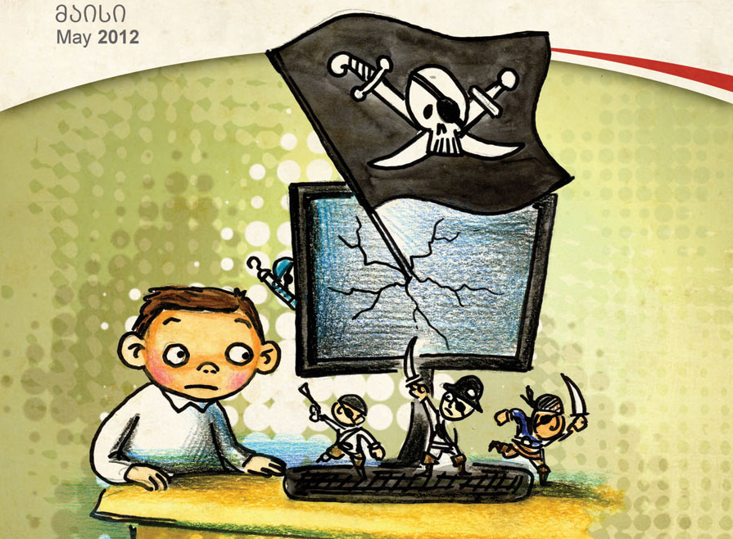
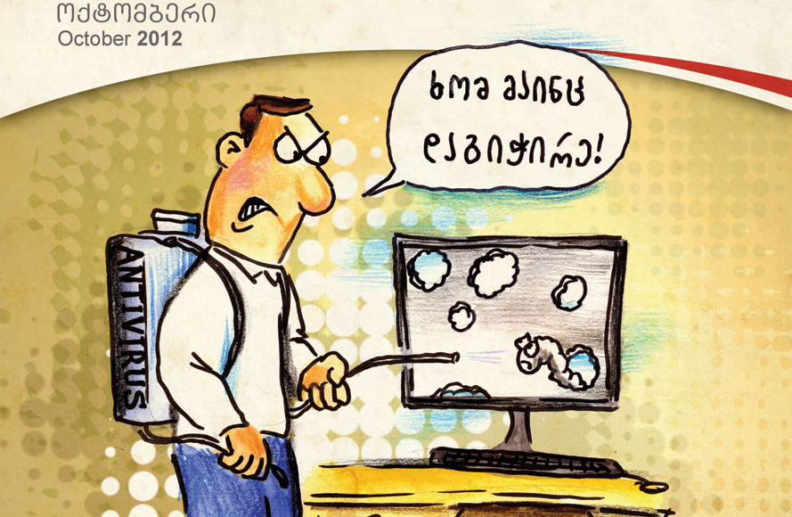






#keypillarsforsuccess
VII. Informed and knowledgeable information society
National Cyber Olympiad - Cyber Cube
Cyber-Exe Georgia
Cyber Class
FIRST international symposium
Awareness Rising Campaigns
Training courses

Slide 13
Why Georgia succeeded?
COMPREHENSIVE APPROACH TO ALL MAJOR BUILDING BLOCKS
STRATEGIC, POLICY ALIGNMENT AND POLITICAL WILLINGNESS
NON-SEPARATION OF INFORMATION SECURITY AND CYBER SECURITY EFFORTS
PRAGMATIC AND RISK-BASED APPROACH
RECOGNIZING IMPORTANCE OF TRUST AND COOPERATION, INFORMAL CHANNELS
INTEGRATION WITH EU INFORMATION AND CYBER SECURITY FRAMEWORKS

Slide 14

Data Exchange Agency:
Address: University Street#50, Tbilisi, Georgia
Phone: +995 (32) 2 91 51 40
E-mail: info@dea.gov.ge ngoderdzishvili@dea.gov.ge
Web: www.dea.gov.ge / www.cert.gov.ge
FB.: მონაცემთა გაცვლის სააგენტო • Data Exchange Agency / CERT.GOV.GE
Sub-regional Conference on the role of information and communication
technologies (ICTs) in the context of regional and international security

