Slide 1
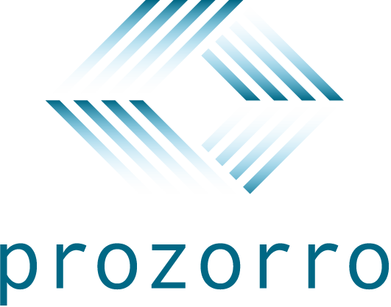
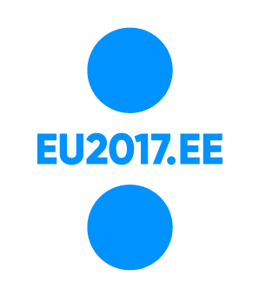
Making public procurement in Ukraine transparent:
ProZorro e-procurement system
Ievgen Bilyk,
Project Manager at Transparency International Ukraine
October, 4th 2017
Notes:
Hello everyone, my name is Ievgen, and today I will present you the situation with transparency in public procurement in Ukraine: the case of new e-procurement system called ProZorro.
Before the slides start, I want to express my gratitude to organizers for inviting TI Ukraine to this conference. I hope that Ukrainian experience will give useful ideas to all participants on what they can implement in their countries.
So, let us begin

Slide 2
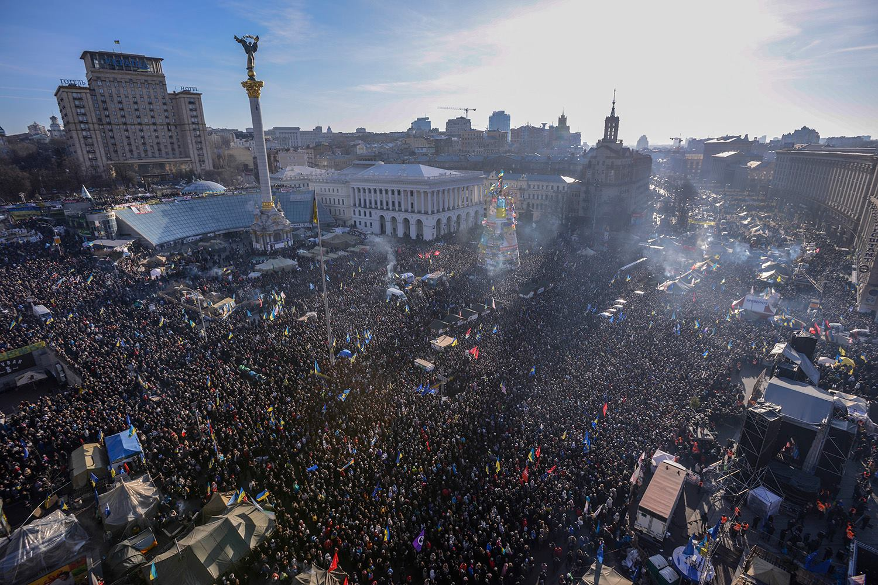
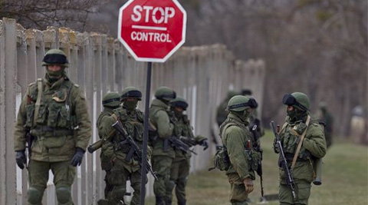
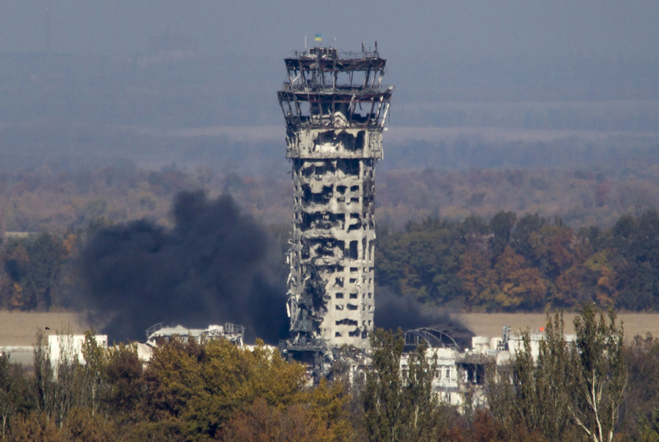
Ukraine: the country goes through difficult times
Notes:
In recent years, Ukraine went through quite difficult moments
Back in 2014, we had a revolution, which ended up with the change of a corrupt government.
But shortly after that, came the annexation of Crimea.
The same year the war for separation of the Eastern regions erupted, and the situation continues to be tough these days

Slide 3
Public procurement: 20% of GDP, major opportunity for corruption
Notes:
Still, these problems are probably not the main ones for the country. Recent sociological surveys show that the first reason most Ukrainians are skeptical about the future of their country is endemic corruption.
We earned only 29 points at Corruption Perception Index 2016, which is a very low score. For instance Spain, an average EU country in terms of corruption perception, scored twice as many: 58 points.
And since 20% of our GDP is spent on public procurement, this is one of the main opportunities for corruption. The losses from it are estimated to be over USD 2 billion per year.
So, if you ever wondered how corruption in public procurement looks like, this is an unfinished bridge in Kyiv, which construction began in 1993, almost 25 years ago.

Slide 4
Short history of ProZorro development
March 2014
Voluntary initiative
September, 2014
Final concept, consolidation of project team
April, 2015
Volunteers become public officials
December, 2015
New law on public procurement
April-May 2014
First concept of the system
February, 2015
Launch of MVP
May, 2015
Piloting with Ministry of Defense
August, 2016
ProZorro goes national
Notes:
With this situation in mind, civic society and business started developing an electonic system for public procurement after the revolution.
In spring 2014, they managed to consolidate the project.
And already in february, 2015, the minimum viable product of the new system was ready.
One year after the project had started, volunteers joined the team of Ministry of Economy and Trade, which is responsible for public procurement policy in Ukraine, and launched a successful pilot with Ministry of Defence as the first procurer.
Till the end of 2015, we had the new law passed by the Parliament, which created legal grounds for launching ProZorro countrywide.
And since August, 2016, the system is obligatory to use for public procurement at national level.

Slide 5
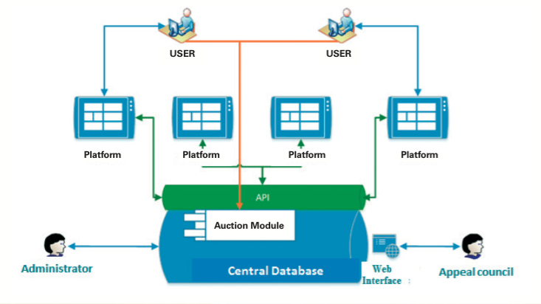
Architecture of the system: everybody can see everything
Notes:
Let us look a bit at the architecture of the system
In the core, we have central database with auction module where bidders compete to reduce the price of procurement.
The second part is electronic platforms that connect to the central database via API. They provide service to the bidders and procurers and receive a fee from successful purchases.
Finally, there is a web interface for appeal council that analyzes the procurements. This way, we implemented the principle everybody sees everything.

Slide 6
Golden triangle of partnership
Government: regulations and data administration
Civic society: data administration during pilot stage and monitoring
Commercial platforms: service for procurers and bidders
Notes:
The core of ProZorro system is the golden triangle of partnership between government, civic society, and business.
Ministry of Economy and Trade of Ukraine is responsible for regulations and policy on public procurement. And state enterprise ProZorro takes care of data storage in the central data base.
TI Ukraine as a representative of civic society held the central database during the pilot stage, before its transfer to the government. Right now we and other civic organizations analyze open data on procurements and appeal to controlling bodies in case of violations.
On the business side, the involvement of electronic platforms that provide services to procuring agencies and suppliers should be highlighted.
I would like to point out that, though the project started as an uproot initiative of civic society and businesses, it would not become possible without governmental support, specifically from MERT, and international donors who supported development of the system.

Slide 7
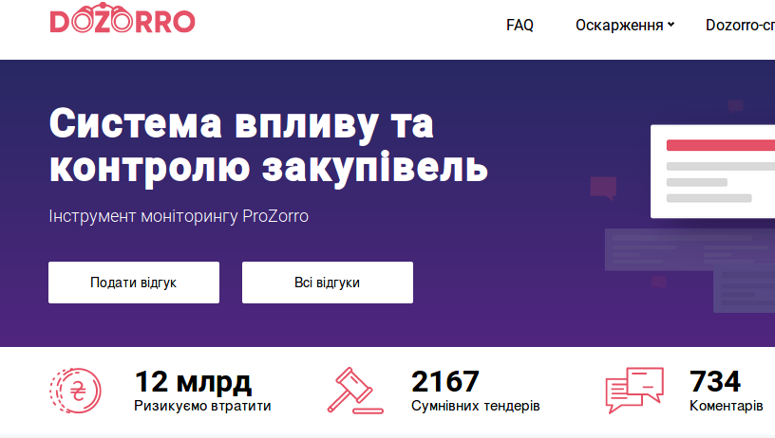
Tools to work with open data in ProZorro
Notes:
And I want to give you a couple of examples of the public tools that harness the potential of open data in ProZorro.
Business analytics module allows government and civic organizations to create detailed reports relying on precise procurement statistics
And Dozorro is a monitoring portal where civic activists and businesses can complain on tenders and engage with public authorities directly.
More tools are under development these days, such as best practice ranking of procurers and automatic risk indicators on tenders.

Slide 8
Is open data enough to achieve transparency in public procurement?
Notes:
So, we have open data in ProZorro and we have powerful instruments to analyze this data. But is this enough to achieve transparency in public procurement? At TI Ukraine we believe that not.
The most important part is the impact from analyzing the data. And here I want to give you an example of possible violations that were disclosed with the help of ProZorro, but which did not bring anyone accountable.
Probably most of you know that Ukraine hosted Eurovision contest this spring. The procurements for the contest were made by national TV agency without calls for open tenders. They used negotiation procedure explaining this use by the urgency of procurements. However, the documents prove that they knew about the need to procure in advance. The subject of procurement was also competitive.
In total, around half a billion in local currency was spent on negotiation procedures for artworks in the second half of 2016. Most of this money was spent on Eurovision contest in non-transparent way.

Slide 9
Making public procurement transparent
Controlling bodies need to gain the trust of procurers and bidders
More violations should be duly punished
Civic society organizations need to increase their expertise
Notes:
I would like to outline some issues that we need to resolve in Ukraine to achieve greater transparency of public procurement
First of all, controlling bodies have low trust from procurers and bidders. For example, the survey of procurers conducted by TI Ukraine together with SE ProZorro this summer revealed that State Audit Service is the most trusted among all controlling bodies. But more than 25% of respondents said they did not believe in the competency of this agency. Other controlling bodies scored even lower results.
And such attitude has certain grounds. Recently, we had some big cases of possible violations of public procurement law revealed via ProZorro. And few of them were duly investigated and punished, which is discussed in the reports by TI Ukraine in detail.
Finally, citizens who monitor public procurements are often not competent enough. We at TI Ukraine educate civic society organizations working in the regions to spot the violations and make appeals to the government. But this regional network has a long way to go in terms of the required level of expertise.
As you can see, despite the achievements of ProZorro, there is a lot of work ahead and we continue making public procurement more transparent.

Slide 10
Thank you!
Notes:
It is all from me. Thank you very much for your attention!

